Slide 1
AMG+: Extended Principles Illustrated on the 1D Helmholtz Equation
Achi Brandt
Oren Livne
James Brannick
Karsten Kahl
The Multigrid Round Table
January 7, 2022

Slide 2
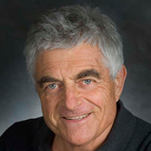
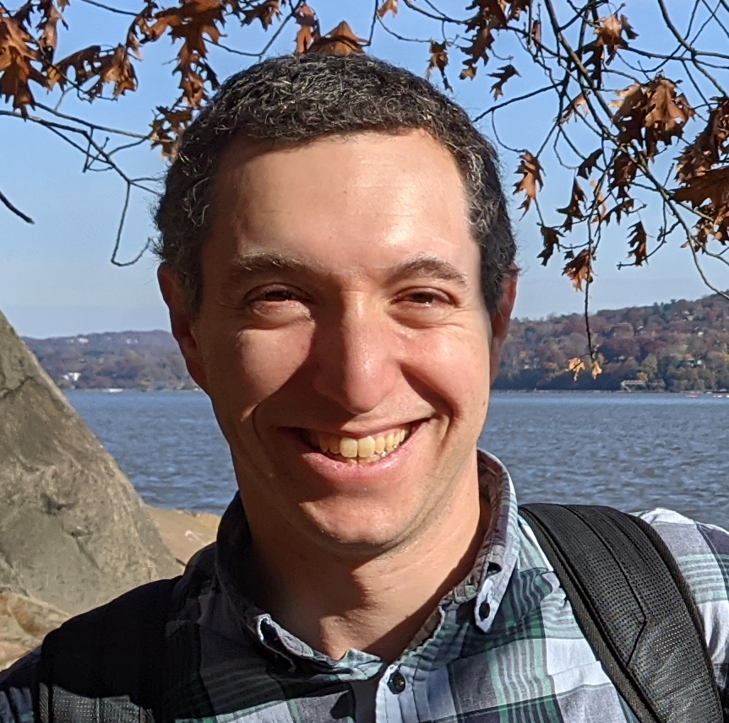
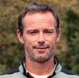
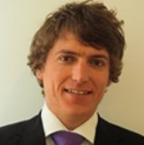
Team
Achi Brandt ACHIBR@GMAIL.COM
Weizmann Institute of Science
UCLA
Oren Livne OREN.LIVNE@GMAIL.COM
Educational Testing Service
James Brannick jjb23@psu.edu
PSU
Karsten Kahl kkahl@uni-wuppertal.de
University of Wuppertal

Slide 3
MOTIVATION
Make AMG work for many new problems
Formulate generalized guiding principles

Slide 4
Multitude of variables/unknowns
Multilevel organization
At each level:
Relaxation
Identifying coarse-level variables
Interpolation
Coarse-level equations
For each step:
Quality Measure
Construction method
4

Slide 5
Successive Quality Measures:
Relaxation: Residual shrinkage factor /work
Coarse variables: Mock cycle convergence factor
Interpolation: Error on test function
Coarse equation: 2-level convergence factor
Sparsity, symmetry
predicts

Slide 6
Coarse Variable construction
Current AMG: coarse variable = a representative/average of several “strongly connected” fine variables.
In many problems (non-elliptic, NN, …) there are no particularly strong connections.
Can coarsen only larger aggregates of moderately connected variables, with several coarse variables per aggregate.
Coarse variables are of different type than fine variables.

Slide 7
PDE Example: Helmholtz Equation
$$\left[∆+k^{2}\right]u\left(x,y\right)=f\left(x,y\right),$$
$$k=k(x,y)$$
Constant $k$: slowly converging errors are approximately
$$\sum_{α^{2}+β^{2}=k^{2}}{A_{αβ}e^{i(αx+βy)}}=\sum{”ray”}$$
$$k$$
Moderate correlation between neighboring error values.
”Multi-coarsening” is required.
Past specialized multi-coarsening failed.
The general systematic approach works.

Slide 8
AMG+ for 1D Helmholtz
Details start here.

Slide 9
The first principle is that you must not fool yourself and you are the easiest person to fool.
--Richard Feynmann
Notes:
We do not want to exploit particular properties of the 1D Helmholtz.
We want to develop AMG for the 1D Helmholtz, but in the process formulate generally useful principles that can apply to many new types of problems.

Slide 10
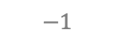
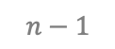
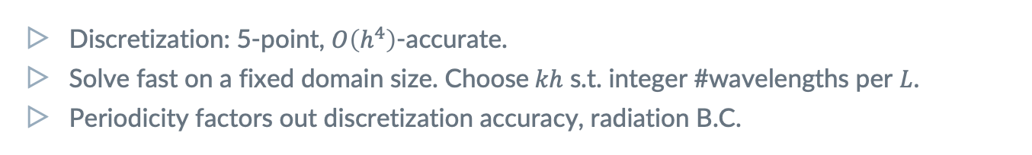
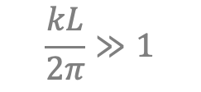
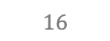
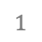
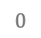
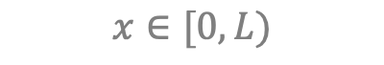
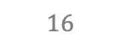
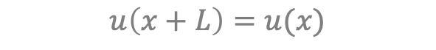
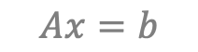
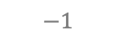
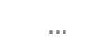
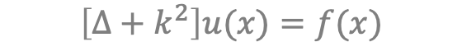
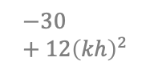
PDE Example: 1D Helmholtz
$$\frac{kL}{2π}≫1$$
$$\left[∆+k^{2}\right]u(x)=f(x)$$
$$x∈[0,L)$$
$$u\left(x+L\right)=u(x)$$
$$0$$
$$1$$
$$…$$
$$n−1$$
$$Ax=b$$
$$−1$$
$$16$$
$$−30+12{\left(kh\right)}^{2}$$
$$16$$
$$−1$$
Discretization: 5-point, $O\left(h^{4}\right)$-accurate.
Solve fast on a fixed domain size. Choose$kh$ s.t. integer #wavelengths per $L$.
Periodicity factors out discretization accuracy, radiation B.C.
Notes:
SOLVE THE 1D HELMHOLTZ EQUATION
Key challenge: automatically derive ray coarse variables from wave fine variables.
Factor out other, unrelated difficulties.
Don’t exploit particulars of Helmholtz or 1D. But --
Develop general guiding principles.

Slide 11
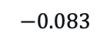
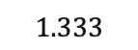
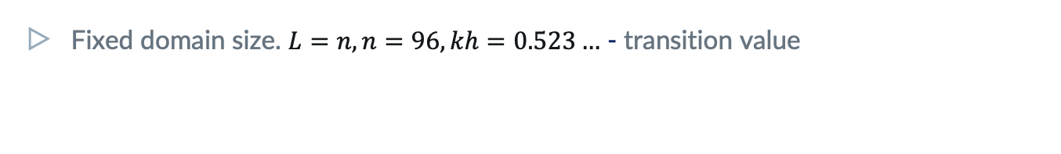
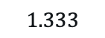
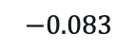
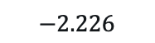
PDE Example: 1D Helmholtz
$$\frac{kL}{2π}≫1$$
$$\left[∆+k^{2}\right]u(x)=f(x)$$
$$x∈[0,L)$$
$$u\left(x+L\right)=u(x)$$
$$0$$
$$1$$
$$…$$
$$n−1$$
$$Ax=b$$
$$−0.083$$
$$1.333$$
$$−2.226$$
$$1.333$$
$$−0.083$$
Fixed domain size. $L=n, n=96, kh=0.523…$ - transition value
Repetitiveness
We can exploit the equations’ repetitiveness for higher efficiency, but that’s a side detail.

Slide 12
1. Relaxation
should exhibit a fast initial residual reduction,
starting from a random initial error.

Slide 13
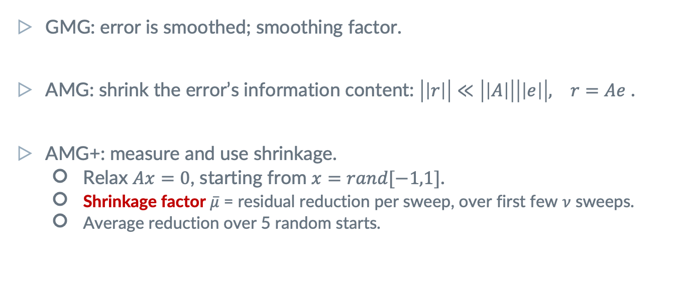
Assessing Relaxation: Shrinkage Factor
GMG: error is smoothed; smoothing factor.
AMG: shrink the error’s information content: $\left|\left|r\right|\right|≪\left|\left|A\right|\right|\left|\left|e\right|\right|, r=Ae$ .
AMG+: measure and use shrinkage.
Relax $Ax=0$, starting from $x=rand[−1,1]$.
Shrinkage factor $\overline{μ}$ = residual reduction per sweep, over first few $ν$ sweeps.
Average reduction over 5 random starts.
Notes:
Achi will make a general comment about relaxation.
Appropriate norm is required for distributive relaxation.
For a symmetric problem, may want to prefer a symmetric relaxation scheme.

Slide 14
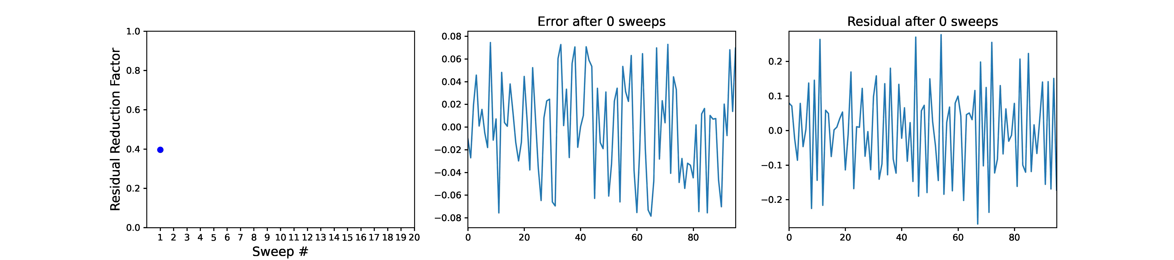
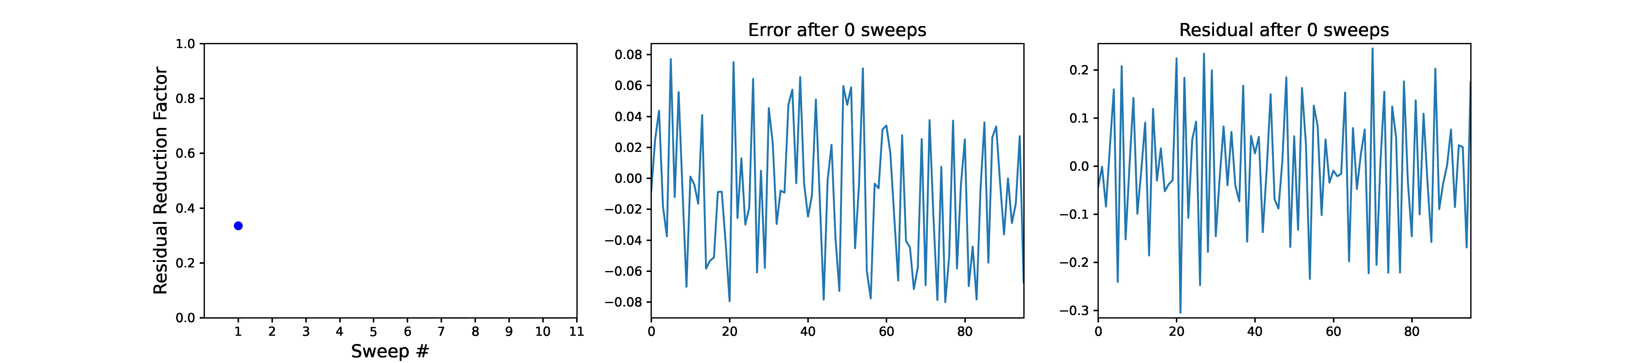
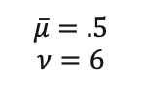
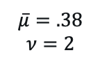
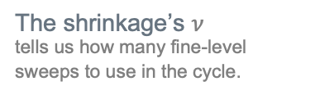
Shrinkage Factor In Action
The shrinkage’s $ν$
tells us how many fine-level sweeps to use in the cycle.
Laplace
GS
$$\overline{μ}=.5$$
$$ν=6$$
Helmholtz
Kaczmarz
$$\overline{μ}=.38$$
$$ν=2$$
14

Slide 15
2. Test Functions
are examples of slowly-converging errors,
which reveal connection strength between variables.

Slide 16
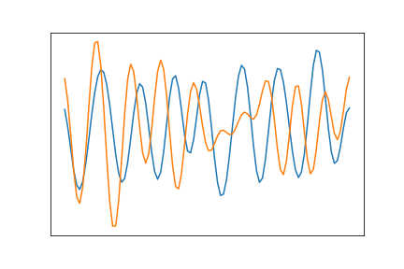
Test Functions (TF) are at the heart of AMG+
Examples of slowly converging errors.
Drive all processes:
Finding neighbors: highly correlated across TFs.
Creating coarse variables.
Fitting interpolation.
TFs are locally smooth.
Gradually improve TFs to lower residuals while adding levels (more on that later: bootstrap).
In non-linear systems,
can still produce such examples.
Notes:
Examples can be constructed also in non-linear systems.

Slide 17
3. Local SVD Coarsening
reveals the right type of coarse variables, and guides the choice of coarsening ratio.

Slide 18
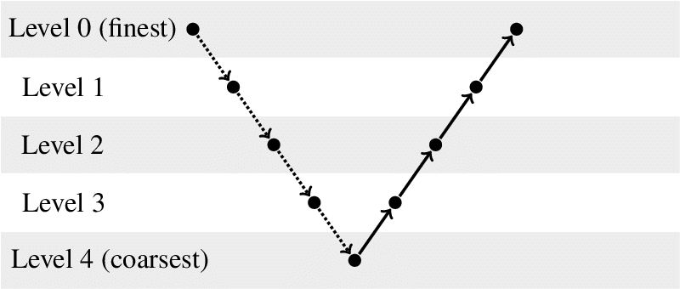
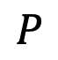
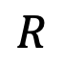
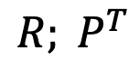
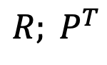
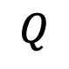
Quick Notation
Coarsening: the definition of coarse variables.
Interpolation: transfer coarse vector to fine level.
Restriction: transfer fine vector to coarse level.
For instance,
$${R; P}^{T}$$
$$R$$
$$P$$
$$Q$$
For instance,
$${R; P}^{T}$$

Slide 19
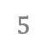
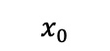
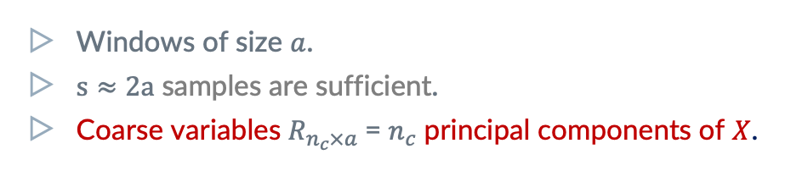

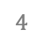
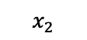
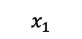
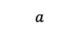
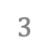
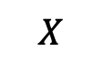
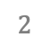
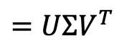

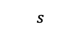
Gather TF samples on an aggregate into a Test Matrix
$$X$$
$$=UΣV^{T}$$
$$a$$
$$x_{0}$$
$$x_{1}$$
$$s$$
$$x_{2}$$
$$…$$
$$0$$
$$1$$
$$2$$
$$3$$
$$4$$
$$5$$
$$…$$
$$n−1$$
Windows of size $a$.
$s≈2a$ samples are sufficient.
Coarse variables $R_{n_{c}×a}$= $n_{c}$ principal components of $X$.
Repetitive case
Multiple samples from one TF.
Multiple coarse vars per aggregate.
As in SA interpolation.
Notes:
In the repetitive case we can take multiple samples from one TF. But this is a side comment.
Principal components = first n_c rows of V^T.

Slide 20


SVD Coarsening in Action: Agg Size $=4$
20
Notes:
Note: for symmetric Kaczmarz I am getting asymmetry in the values of R[0] just like for non-symmetric Kaczmarz. James mentioned they got symmetric for symmetric Kaczmarz.

Slide 21



SVD Coarsening in Action: Agg Size $=6$
$n_{c}$ = # coarse variable species.
Helmholtz: $n_{c}=2$ is natural: cos/sin, left/right waves.
21

Slide 22

How many components to use?
s.t. unexplained variance ${\text{UV}\text{:=}\text{(}\sum_{i≥n_{c}}{σ_{i}^{2}}/\sum_{i}{σ_{i}^{2}})}^{1/2}$ small (< .1).
For Laplace, aggregate size 2, $n_{c}=1$ yields $UV\sim .1$;
BUT $R$is piecewise constant, not so good enough as interpolation.
Use SVD to provide tentative values of coarsening ratios.
The actual number of components to be determined by the quantitative predictor of cycle convergence.

Slide 23
4. Quantitative Quality Prediction
allows designing each multilevel component separately and reliably (coarsening & cycle).

Slide 24


Mock Cycle: Predictor of 2-level Convergence
Start with random ${x=x}_{0}$.
$\text{MockCycle}\left(R, ν\right):$
Relax $ν$ times.
Update $x$ such that $Rx=Rx_{0}.$
Direct solver/Kaczmarz
To project.
$$x←x−R^{T}{\left(RR^{T}\right)}^{−1}R(x−x_{0})$$
Use Mock Cycle asymptotic convergence factor as the ultimate coarsening quality test.
Determines the optimal aggregate size and #components.

Slide 25


Mock Cycle in Action: Convergence
 | $$ν=1$$ | $$2$$ | $$3$$ | $$4$$ | $$5$$ | $$6$$ | $$7$$ | UV*
4/2 | .49 | .29 | .18 | .12 | .088 | .056 | .054 | .025
6/3 | .52 | .29 | .18 | .12 | .098 | .078 | .064 | .013
6/2 | .84 | .67 | .62 | .53 | .45 | .37 | .33 | .080
${\text{* }\text{UV}\text{:=}\text{(}\sum_{i≥n_{c}}{σ_{i}^{2}}/\sum_{i}{σ_{i}^{2}})}^{1/2}$

Slide 26



Mock Cycle in Action: Efficiency
 | $$ν=1$$ | $$2$$ | $$3$$ | $$4$$ | $$5$$ | $$6$$ | $$7$$ | UV
4/2 | .73 | .73 | .74 | .76 | .79 | .80 | .82 | .025
6/3 | .72 | .73 | .75 | .77 | .79 | .81 | .83 | .013
6/2 | .89 | .89 | .90 | .90 | .90 | .90 | .90 | .080
Guides the coarsening $R$.
Compare different choices. Reduction per relaxation sweep $≈$ smoothing rate, up to accuracy limit.
Generalizes LFA.
Quantitative numerical predictors > theory.
Guides the interpolation $P$.
2-level rates should attain mock cycle rates.
Prefer small aggregate size.
To avoid long-range interpolation.

Slide 27
5. Interpolation
is constructed to accurately reproduce TFs, but tested via two-level cycle rates.

Slide 28







Least-Squares Fitting to TFs
$$X$$
$$0$$
$$1$$
$$2$$
$$3$$
$$X^{c}=Rx$$
Caliber = 2: $P=R^{T}$
Caliber = 4
Notes:
As in BAMG.
Solve LS problem using SVD: reused for efficient $α$search.

Slide 29



Mock cycle predicts the ‘ideal’ 2-level rates
 | $$ν=1$$ | $$2$$ | $$3$$ | $$4$$ | $$5$$ | $$6$$ | $$7$$ | Fill-in | $$|A−A^{T}|$$
4/2 | .49 | .29 | .18 | .12 | .09 | .06 | .05 | - | -
$$RAR^{T}$$ | .58 | .46 | .41 | .37 | .36 | .32 | .32 | 1.2 | 0
$$RAP$$ | .51 | .28 | .17 | .12 | .09 | .07 | .06 | 1.2 | 0.0046
$$P^{T}AP$$ | .52 | .27 | .14 | .09 | .07 | .05 | .04 | 2.0 | 0
$P$: caliber 4
$ν=30$
2-level rate guide the choice of $P$.
TF reconstruction $l_{2}$ or unexplained variance are bad predictors.

Slide 30


Coarse-level Equations
-0.08 | 1.33 | -2.23 | 1.33 | -0.08
Wave Equation
0.20 | 0.34 | -0.17 | 0.01 | 0.20 | -0.32
-0.32 | -0.56 | 0.01 | -1.46 | 0.34 | -0.56
$$RAR^{T}$$
Ray Equations
0.15 | 0.17 | -0.03 | 0.00 | 0.15 | -0.17
-0.17 | -0.16 | 0.01 | -0.63 | 0.17 | -0.16
$$RAP$$
Symmetrize: replace $R$ by $Q$ (by small edit) and use $QAP$ instead. Does not affect initial cycles.

Slide 31


Coarse Variables capture local TF

Slide 32
6. Bootstrap
Improves and reveals test functions as more levels are gradually added to the multilevel solver.

Slide 33



Improve TFs while adding levels
Build $R, P$
Cycle
TFs
Relax on $Ax=0$
Random starts
Mini-cycle on $Ax=0$
Only good shrinkage is needed, not asymptotic convergence.
Near null-space functions eventually revealed after many levels.
Notes:
Mini-cycle is more efficient in reducing the residual, so saves setup work.
Unclear if we need to bootstrap in this case – a small # relaxations on TFs or using more samples has been good enough so far.

Slide 34



Mini-Cycle Shrinkage in Action
Kaczmarz
2-level Cycle(2,2;4)
Mini-cycle shrinks well,
more efficiently than relaxation, even if it is asymptotically slow.
$\overline{μ}=.58$
$\overline{ν}=6$
$\overline{μ}=.04$
${\overline{μ}}^{1/W}=.38$
34

Slide 35


3-level Cycle Works
 | $$ν=3$$ | $$4$$ | $$5$$ | $$6$$ | $$7$$ | Fill-in | $$|A−A^{T}|$$
Mock | .18 | .12 | .09 | .06 | .05 | - | -
0 -> 1 Shrinkage | .36 | .24 | .23 | .23 | .11 | 1.2 | 0
1 -> 2 Shrinkage | .34 | .24 | .16 | .13 | .11 | 1 | 0
3-level, V | .81 | .31 | .20 | .16 | .11 | - | -
$QAP, P$: caliber 4

Slide 36
7. Coarse-level Construction is Local,
which is especially useful for repetitive problems & upscaling.

Slide 37

Coarse-level Construction is Local
Relaxation is local, so producing TFs is local.
Coarse-variable construction only requires local samples.
Mock cycle rate well estimated on domain size = $4 × \text{aggregate}\text{_}\text{size}$.
Two-level cycle rate well estimated on domain size = $4 × \text{aggregate}\text{_}\text{size}$.
Only shrinkage matters, not asymptotic rate.
Notes:
In graph problems, define domain as a graph neighborhood of a node.

Slide 38

Recap of AMG+ Principles
Relaxation should have good shrinkage.
Test Functions (TFs) drive everything: coarsening, interpolation, multilevelling.
Coarse-level variables are obtained by local TF SVD and tested by the mock cycle.
Quantitative quality prediction tools, e.g., the mock cycle, guide the separate design of each multigrid component.
Interpolation is constructed by least-squares fitting of TF values, but ultimately tested via the 2-level cycle shrinkage factor.
TFs & cycle are iteratively improve each other via bootstrap.
Coarse-level construction is a local process and supports upscaling.

Slide 39
Thanks!
Questions/Ideas for Applications?
Twitter
#AMG+
Email us at
achibr@gmail.com
oren.livne@gmail.com
jjb23@psu.edu
kkahl@uni-wuppertal.de

Slide 40
EXTRA SLIDES

Slide 41






















Challenging Problems for AMG
Nearly Singular
Systems
Species are not explicitly identified
Highly indefinite
Emerging types of coarse variables
$$\left|ε\left(x\right)\right|≪\frac{1}{\text{L}}$$
$\left[∆ − ε{\left(x\right)}^{2}\right]u\left(x\right)=f\left(x\right)$,
$$V$$
$$V$$
Stokes
$$U$$
$$P$$
$$U$$
$$P$$
$$U$$
$$V$$
$$V$$
$$U$$
$$P$$
$$U$$
$$P$$
$$U$$
$$V$$
$$V$$
$$\left[∆+k^{2}\right]u=f$$
$$k≫\frac{1}{\text{L}}$$
Multiple types: directional rays
$$k$$
41

Slide 42


Challenging Problems for AMG (Cont.)
Upscaling
Deriving equations at increasingly coarser scale
Creating interpretable coarse-level variables
Non-linear systems
where a coarse version is not given
Inverse Problems
Non-local equations
Stochastic Optimization
No geometric locations
No locality graph
$$\int{g\left(x,y\right)u\left(y\right)dy=}f(x,u)$$
Neural networks
42
Notes:
This work was inspired by work on challenges in neural networks, which include the last 3 items in this list. (and more)

Slide 43

Systematic Upscaling (WIP)
Deriving equations at increasingly coarser scale.
Creating interpretable coarse-level variables.
Step 1:
Take a large enough, fixed size domain.
Derive all levels’ $R, P$, operators.
Tile & use them on a larger domain.
Step 2:
Double domain size on every coarsening stage.

Slide 44



Save Setup Cost by Switching $Q$’s
Smooth TFs more efficiently by mini-cycles with $P=R^{T}$ to obtain high-order $P$.
$R$ requires only little smoothing.
Setup work dominated by SVD, though.
Temporarily work with expensive, accurate operator for 2-level bootstrapping ($A^{c}=P^{T}AP$).
Post-processing:
Sparsify: $A^{c}=RAP$.
Symmetrize $A^{c}=QAP$.
AMG+ uses $R$!
For the first time, $R$is not just a prediction tool (mock cycle), but used in bootstrap & solver.
Notes:
We are free to switch between different Q’s during setup.

